Slide 1
Real-time Synthesis of Multiple Video Streaming based on 3D Gaussian Splatting
A Proposal by Siyan HU, 12217679

Slide 2
Content
Must Know: View Synthesis, Color rendering
Problem and Motivation
Method: NeRF, 3D Gaussian Splatting
Expectations

Slide 3
Must Know
View Synthesis, Color rendering

Slide 4
View Synthesis History
Morphing
Image-Based Rendering (IBR)
Lumigraph
KinectFusion by Microsoft
Generative Query Network (GQN) by Google and Generative Adversarial Networks (GAN)
Neural Radiance Field (NeRF)

Slide 5
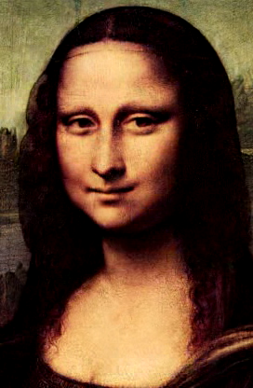

View Synthesis History
Morphing:
Select Source and Destination Images
Establish Correspondences
Generate Intermediate Shapes and Colors
Render the Morphing Sequence
[1] https://homes.cs.washington.edu/~seitz/vmorph/vmorph.htm

Slide 6
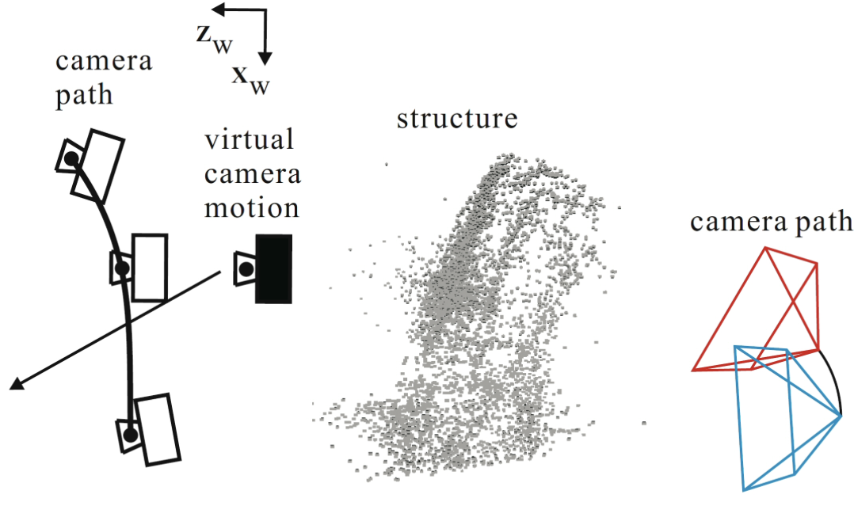
View Synthesis History
Image-Based Rendering (IBR):
Input Collection / Output Image
Correspondence Information: EACH PAIR
Implicit geometry
Explicit depth
Image Warping (Transformation) and Blending [1]
[2] N. Ichimura:``Image-Based Rendering by Virtual 1D Cameras,'' Proc. Pacific-Rim Symposium on Image and Video Technology (PSIVT2009), pp.423-435, 2009

Slide 7
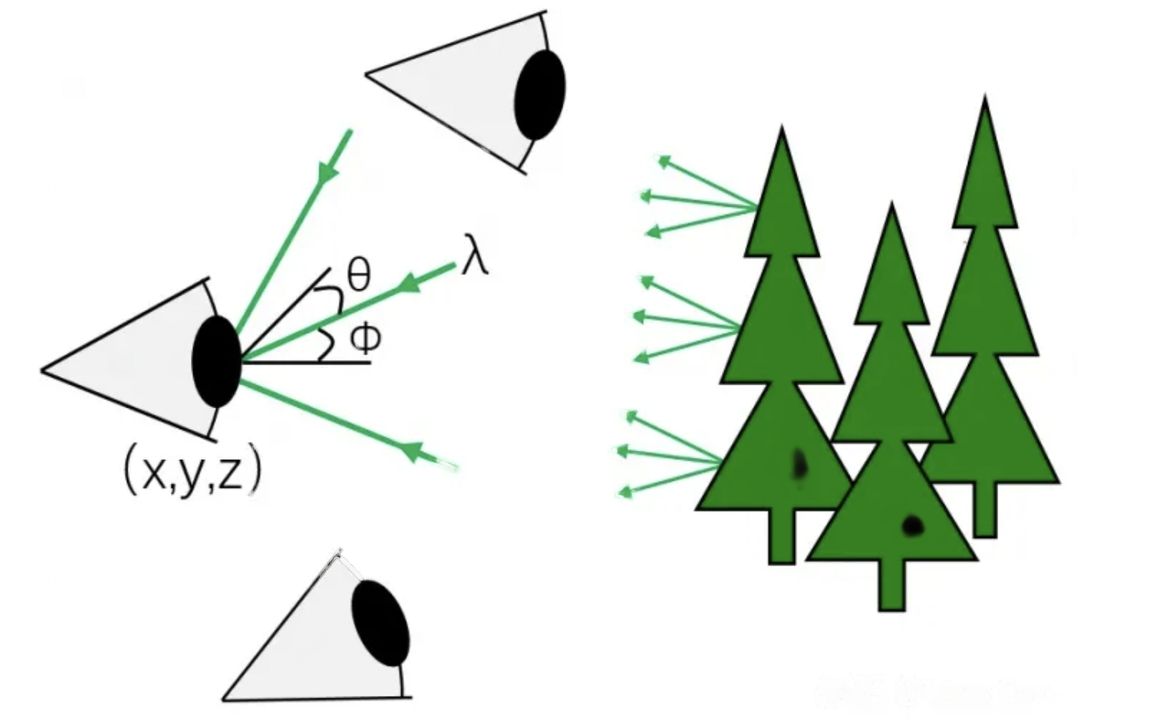
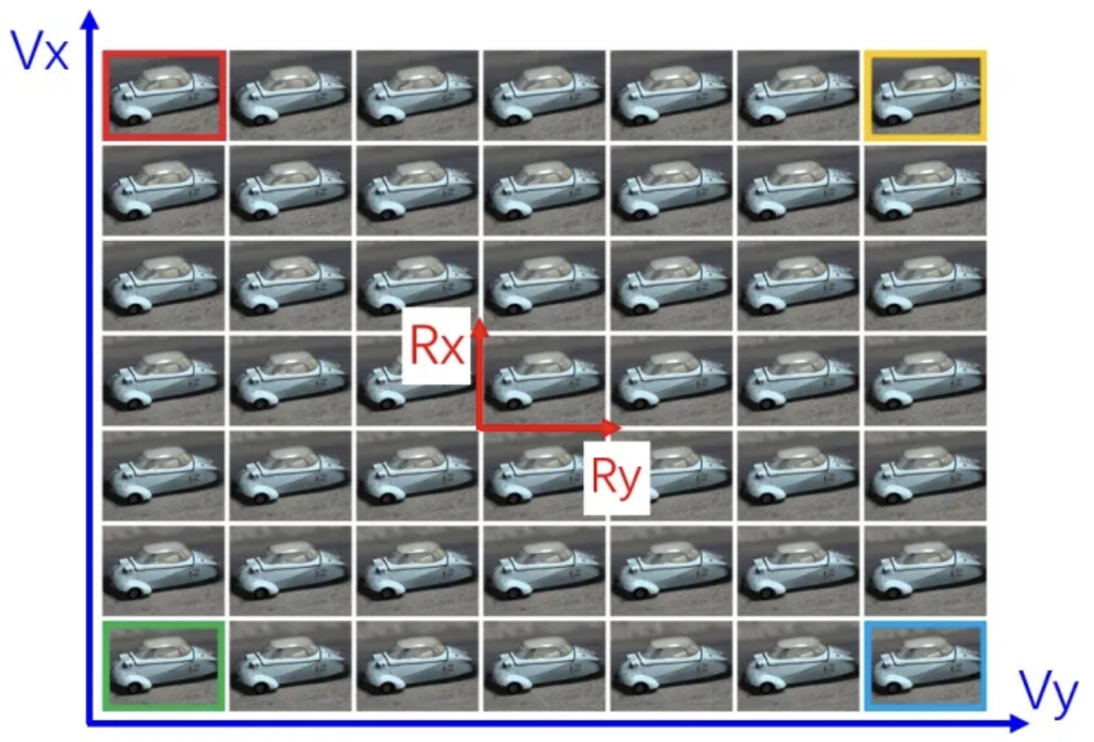
View Synthesis History
Lumigraph
Pixel: 7-dimensional vector:
position of human eye P(𝑥, 𝑦, 𝑧)
input angle of ray to human eye: d(𝜃 , 𝜙)
the wavelength of ray: 𝜆
timestamp: 𝑡
Resolution of View: FoV and FoP
FoV: field of view
FoP: field of Parallax
[3] https://www.zhihu.com/topic/19654717/hot

Slide 8
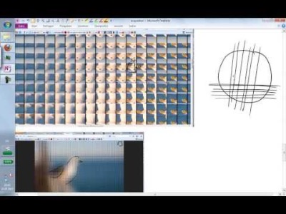
View Synthesis History
Lumigraph
Pixel: 7-dimensional vector:
position of human eye P(𝑥, 𝑦, 𝑧)
input angle of ray to human eye: d(𝜃 , 𝜙)
the wavelength of ray: 𝜆
timestamp: 𝑡
Resolution of View: FoV and FoP
FoV: field of view
FoP: field of Parallax
[4] https://youtu.be/q_zVV89nU3g?si=avYmrJnBB8Xwpfbm&t=2851

Slide 9
Color Rendering History
Flat Shading
Phong reflection model
Image-Based Rendering (IBR)
Volume Rendering

Slide 10
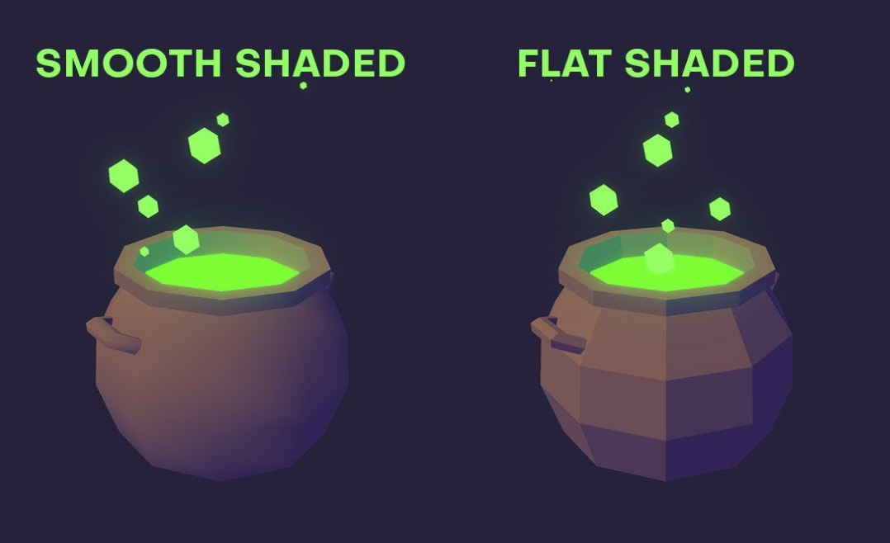
Color Rendering History
Flat Shading: polygon based
[5] https://www.youtube.com/watch?v=BXdHfeJrmCo

Slide 11
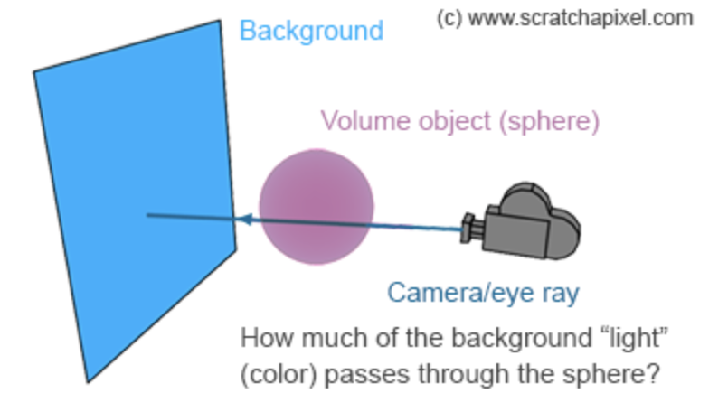
Color Rendering History
Volume Rendering:
dealing with the rendering of non-solid objects with low density.
Abstraction:
substances such as gas into a group of erratic particles
light passes through such objects
the process of photons colliding with particles.
[6] https://www.scratchapixel.com/lessons/3d-basic-rendering/volume-rendering-for-developers/intro-volume-rendering.html

Slide 12
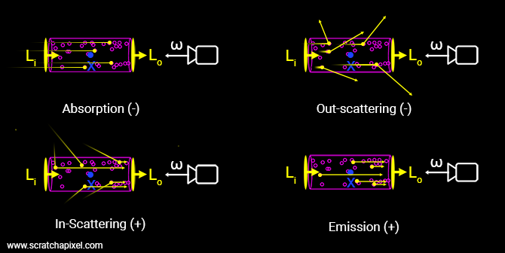
Color Rendering History
Volume Rendering:
Interactions:
Absorption
Emission
In/Out – Scattering
[7] https://www.scratchapixel.com/lessons/3d-basic-rendering/volume-rendering-for-developers/intro-volume-rendering.html

Slide 13
Problem and Motivation

Slide 14
Problems
Live streaming events where multiple perspectives need to be merged seamlessly.
Virtual reality applications where the user's perspective can shift quickly and dramatically.
Teleconferencing situations where multiple participants' video streams may need to be blended.
Ad-hoc SLAM where people need a fast and safe deployment of site survey.
Motivations
To learn 3D reconstruction and view synthesis as a beginner
To try apply what I have learnt in this semester.
To contribute to future research projects.
To develop a more efficient and visually pleasing application for my own use.

Slide 15
Method
NeRF, 3D Gaussian Splatting

Slide 16
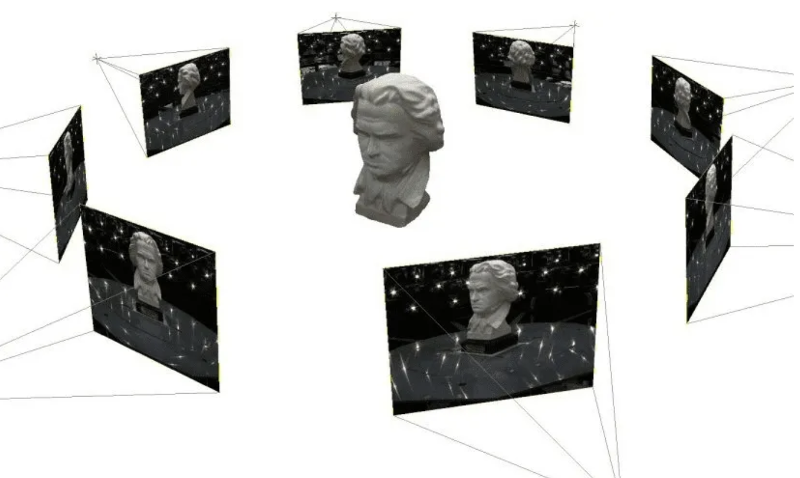
Neural Radiance Field (NeRF)
Input 5D coordinate {x, y, z, θ, φ}, current point (x, y, z), direction (θ, φ).
Output Color and density.

Slide 17
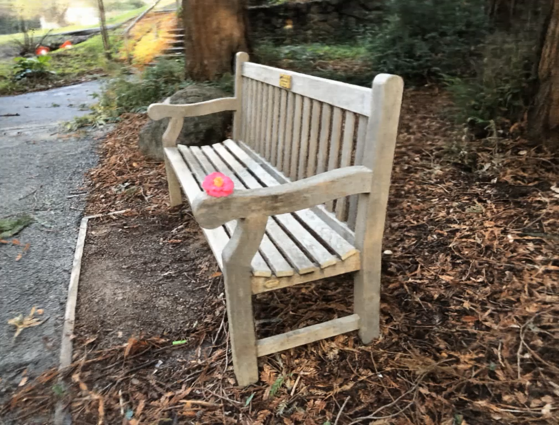
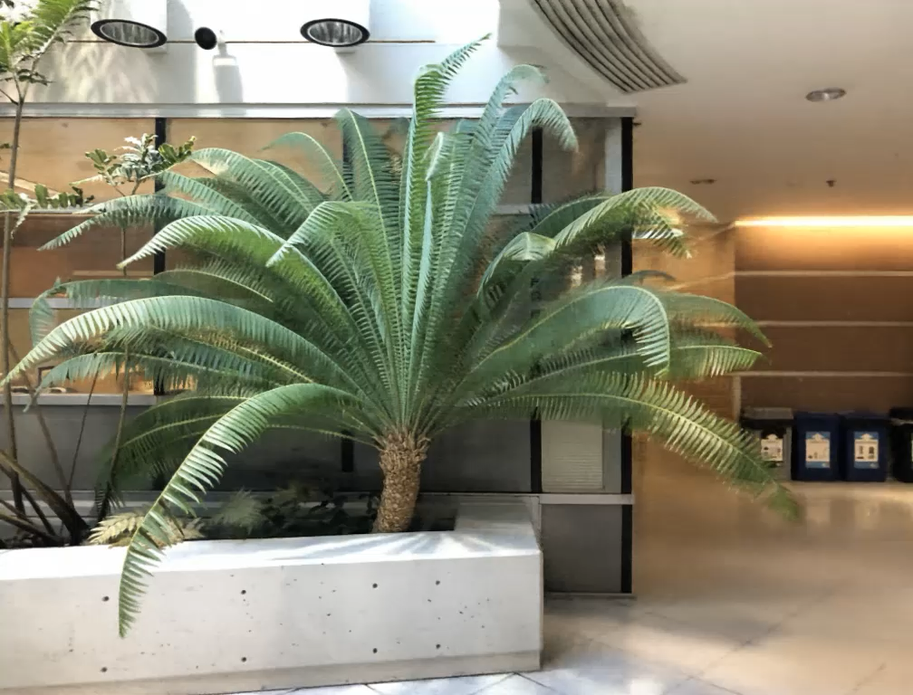
Neural Radiance Field (NeRF)
Input 5D coordinate {x, y, z, θ, φ}, current point (x, y, z), direction (θ, φ).
Output Color and density.
[7] Ben Mildenhall, Pratul P. Srinivasan, Matthew Tancik, Jonathan T. Barron, Ravi Ramamoorthi, and Ren Ng. Nerf: Representing scenes as neural radiance fields for view synthesis. In ECCV, 2020.

Slide 18
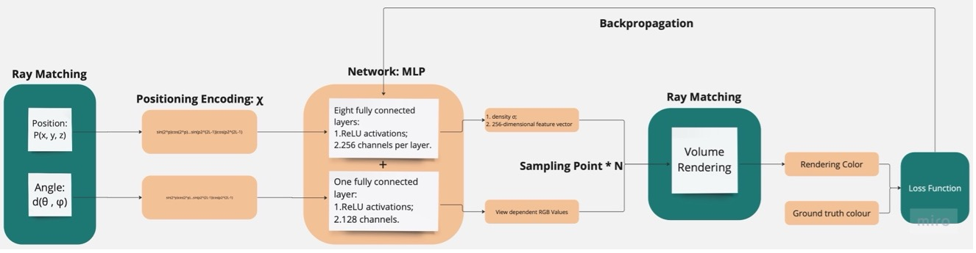
Neural Radiance Field (NeRF)
Input 5D coordinate {x, y, z, θ, φ}, current point (x, y, z), direction (θ, φ).
Output Color and density.
[7] Ben Mildenhall, Pratul P. Srinivasan, Matthew Tancik, Jonathan T. Barron, Ravi Ramamoorthi, and Ren Ng. Nerf: Representing scenes as neural radiance fields for view synthesis. In ECCV, 2020.

Slide 19
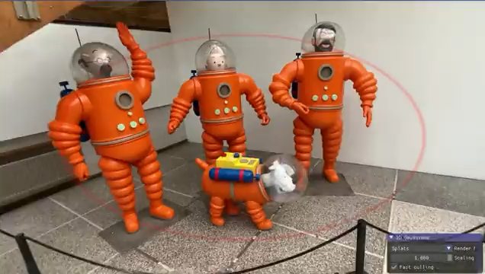
3D Gaussian Splatting
[8] https://www.youtube.com/watch?v=BXdHfeJrmCo

Slide 20
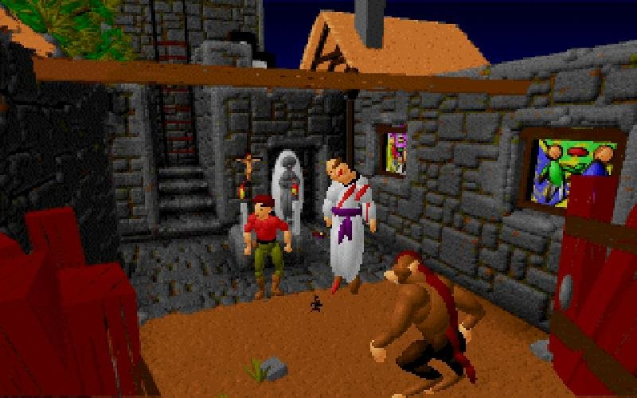
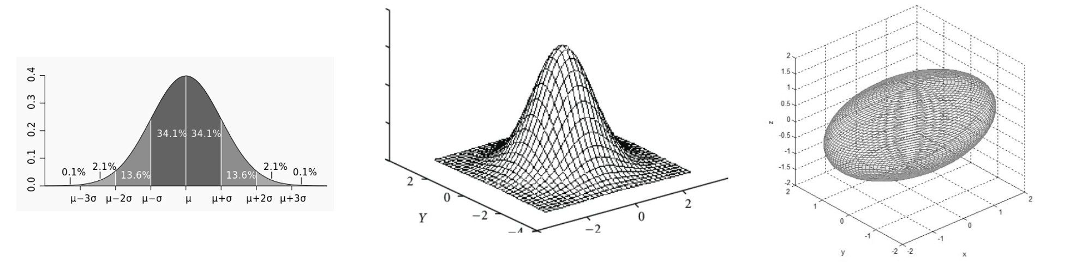
3D Gaussian Splatting
3D Gaussian
1D, 2D, 3D
Generate as ellipsoid
A delicate balance between differentiability and discreteness:
a single Gaussian: a small differentiable space
multiple Gaussian: can be rendered in parallel rasterization.
[9] https://youtu.be/DT3uKKvVGwI?si=Ty7C0wIo-1TvB0YD

Slide 21
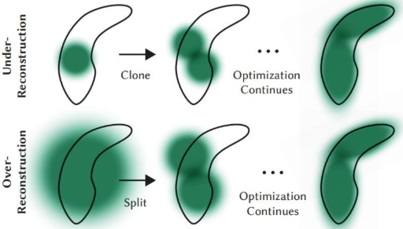
3D Gaussian Splatting
If some 3D Gaussian of a point generated is too large to fully fit the details of that point, the point is segmented and expressed by two points; if the points at a certain point are too dense, multiple 3D Gaussian represents are merged into one.
[10] https://www.reshot.ai/3d-gaussian-splatting

Slide 22
Previous Work
Done by pioneers:
NeRF with classical ray casting method
3D Gaussian Splatting with unit resolution output

Slide 23
Confirmed Novelty
Different camera extrinsic and intrinsic with as less overlapping as possible.
Real-time synthesis via commercial mobile devices.

Slide 24
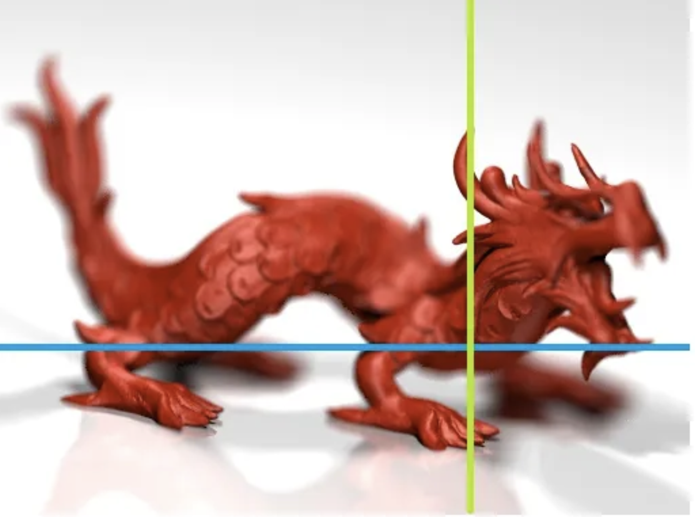
Possible Novelty
Multiple-resolution rendering to better reduce the computing consumption:
Possible? Tile-rendering of course!
Why? Multi-resolution shading saves 20% power: NVIDIA. Maybe later we have edge NeRF!
Steps:
Detect focusing area:
AVDeviceCapture
with camera intrinsics and segment, and iPhone camera sensors
Generate different 3D Gaussian cluster
Render separately

Slide 25
Expectations
Technical Outcome
Development an application that can efficiently synthesize multiple video streams in real-time and render them in a fast way
Successful implementation of multi-resolution rendering, where different areas of the scene are rendered at different levels of detail based on factors such as distance, importance, and motion.
Video streams from various sources without significant lag or quality loss.
Research Contribution
Evaluation of the effectiveness and limitations of the proposed 3D Gaussian splatting technique for real-time video synthesis.
Insights into the challenges and solutions related to real-time video synthesis, including issues related to data volume, processing speed, resolution, and visual consistency.
New knowledge and techniques that can be used in future research and development in the field of video synthesis and real-time SLAM.

Slide 26
Schedule
Completed
1. 3D Reconstruction
2. SfM Point Cloud Generation
Pending:
3. Dataset Collection
4. 3D Gaussian Splatting: this week
5. Rasterization: this week
6. Video Synthesis: 1 week starting from Nov 6.
7. Output Streaming: 1 week from Nov 13.
8. Set up data collector on iPhone and iPad: starting from Nov 20.

Slide 27

Thank you!
Email: shuas@connect.ust.hk

